Slide 1
Unit I : Assembler Course : Language Processor and Compiler Construction
Manisha Mali
manisha.mali@viit.ac.in
BRACT’S, Vishwakarma Institute of Information Technology, Pune-48
(An Autonomous Institute affiliated to Savitribai Phule Pune University)
(NBA and NAAC accredited, ISO 9001:2015 certified)
Department of Computer Engineering

Slide 2

Content
Part – I : Introduction
Need of System Software,
Components of System Software
Language Processing Activities
Fundamentals of Language Processing
Interpreter
Part- II : Assemblers
Elements of Assembly Language Programming
A simple Assembly Scheme
Pass structure of Assemblers
Design of Two Pass Assembler

Slide 3
Passes of a language processor
Pass I
Performs analysis of the source program and note relevant information
Pass II
Perform synthesis of target program

Slide 4
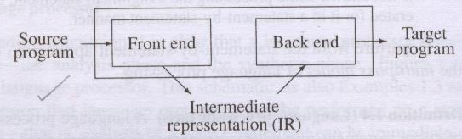
Intermediate representation

Slide 5
ASSEMBLER
Assembler is a program that turns symbols into machine instructions.
Assembler is a program which translates assembly language program in machine language program.

Slide 6
Introduction to assembly language
Mnemonic operation code (Mnemonic opcode)
Symbolic operands
Data declarations

Slide 7
An assembly language program for factorial of a number (N!).
 | START | 101
 | READ | N
 | MOVER | BREG, ONE
 | MOVEM | BREG, TERM
AGAIN | MULT | BREG, TERM
 | MOVER | CREG, TERM
 | ADD | CREG, ONE
 | MOVEM | CREG, TERM
 | COMP | CREG, N
 | BC | LE, AGAIN
 | MOVEM | BREG, RESULT
 | PRINT | RESULT
 | STOP
N | DS | 1
RESULT | DS | 1
ONE | DC | ‘1’
TERM | DS | 1
 | END

Slide 8
 | START | 101
 | READ | N |  | 101) | + | 09 | 0 | 113
 | MOVER | BREG, | ONE | 102) | + | 04 | 2 | 115
 | MOVEM | BREG, | TERM | 103) | + | 05 | 2 | 116
AGAIN | MULT | BREG, | TERM | 104) | + | 03 | 2 | 116
 | MOVER | CREG, | TERM | 105) | + | 04 | 3 | 116
 | ADD | CREG, | ONE | 106) | + | 01 | 3 | 115
 | MOVEM | CREG, | TERM | 107) | + | 05 | 3 | 116
 | COMP | CREG, | N | 108) | + | 06 | 3 | 113
 | BC | LE, | AGAIN | 109) | + | 07 | 2 | 104
 | MOVEM | BREG, | RESULT | 110) | + | 05 | 2 | 114
 | PRINT | RESULT |  | 111) | + | 10 | 0 | 114
 | STOP |  |  | 112) | + | 00 | 0 | 000
N | DS | 1 |  | 113)
RESULT | DS | 1 |  | 114)
ONE | DC | ‘1’ |  | 115)
TERM | DS | 1 |  | 116)
 | END

Slide 9
Assembly Language Syntax
Each line of a program is one of the following:
an instruction
an assember directive (or pseudo-op)
a comment
Whitespace (between symbols) and case are ignored.
Comments (beginning with “;”) are also ignored.
An instruction has the following format:
LABEL OPCODE OPERANDS ; COMMENTS
optional
mandatory

Slide 10



Statement Format
Optional
Optional
Label
Opcode
Operand
specification
, Operand
Specification

Slide 11
A simple assembly language
I am always a register..!!!
Operand1
Statement
Operand2
I am always a symbolic name..!!!

Slide 12
MOVER and MOVEM
· MOVEM
MOVEM | Source | , Dest
· MOVER
MOVER | Dest | , Source

Slide 13
Operand specification
Symbolic name |  | + (Displacement) |  | Index register
AREA+5(4)

Slide 14
Assembly language statements
Imperative statements
Indicate an action to be performed during the execution.
Declarative statements
[label] DS <constant>
[label] DC <value>
A DS 1
B DS 1
ONE DC ‘1’
Assembler directives
START <constant>
END [<operand spec >]

Slide 15









An action to be performed during execution
For declaring constants or assigning value
Instructs the assembler to perform certain actions
Imperative
Assembler
directives
Declaration

Slide 16




Declaration Statements
DS
(Declare Storage)
Reserves area of memory and associates names with them
Example : A DS 1
DC
(Declare constant)
Construct memory words containing constants
ONE DC ‘1’

Slide 17


What is the use of constants?
DC doesn’t really implement the constants because…
These values are not protected by assembler
They may be changed by moving the new value in that memory word.
ONE DC ‘1’
MOVEM BREG,ONE

Slide 18


1. A constant as immediate operand
ADD AREG,5
Our assembly language doesn’t support this..!!
How to write equivalent instructions for this??
ADD AREG,FIVE
----
DC ‘5’
FIVE

Slide 19







2. Literal
???
??
· Operand with syntax = ‘ value ’
What is the Difference between literal and constant..??
ADD AREG, =‘5’
The location of a literal can't be specified. So its value can't be changed like constant…

Slide 20
2. Literal
???
??
What is the Difference between literal and immediate operand..??
( Literal )
ADD AREG, =‘5’
No Architectural provision is needed for literal like immediate operand..
( Imm. operand )
ADD AREG,5

Slide 21





Assembler Directives
1. START
<constant>
The first word of the target program should be placed in the memory word with the address specified..
Indicates the end of the source program..
2. END
[<op spec>]

Slide 22
An assembly language program for factorial of a number (N!).
 | START | 101
 | READ | N
 | MOVER | BREG, ONE
 | MOVEM | BREG, TERM
AGAIN | MULT | BREG, TERM
 | MOVER | CREG, TERM
 | ADD | CREG, ONE
 | MOVEM | CREG, TERM
 | COMP | CREG, N
 | BC | LE, AGAIN
 | MOVEM | BREG, RESULT
 | PRINT | RESULT
 | STOP
N | DS | 1
RESULT | DS | 1
ONE | DC | ‘1’
TERM | DS | 1
 | END

Slide 23
Advantages of assembly language
Machine language program needs to be changed drastically if we modify the original program.
It is more suitable when it is desirable to use specific architectural features of a computer…
Example – special instructions supported by CPU

Slide 24
 | START | 101
 | READ | N |  | 101) | + | 09 | 0 | 113
 | MOVER | BREG, | ONE | 102) | + | 04 | 2 | 115
 | MOVEM | BREG, | TERM | 103) | + | 05 | 2 | 116
AGAIN | MULT | BREG, | TERM | 104) | + | 03 | 2 | 116
 | MOVER | CREG, | TERM | 105) | + | 04 | 3 | 116
 | ADD | CREG, | ONE | 106) | + | 01 | 3 | 115
 | MOVEM | CREG, | TERM | 107) | + | 05 | 3 | 116
 | COMP | CREG, | N | 108) | + | 06 | 3 | 113
 | BC | LE, | AGAIN | 109) | + | 07 | 2 | 104
 | MOVEM | BREG, | RESULT | 110) | + | 05 | 2 | 114
 | PRINT | RESULT |  | 111) | + | 10 | 0 | 114
 | STOP |  |  | 112) | + | 00 | 0 | 000
N | DS | 1 |  | 113)
RESULT | DS | 1 |  | 114)
ONE | DC | ‘1’ |  | 115)
TERM | DS | 1 |  | 116)
 | END

Slide 25



START READ MOVER MOVEM MULT MOVER ADD MOVEM COMP BC
DIV
101
N
BREG, ONE BREG, TERM BREG, TERM CREG, TERM CREG, ONE CREG, TERM CREG, N
LE, AGAIN
BREG, TWO
101) + 09 0 114
102) + 04 2 116
103) + 05 2 117
104) + 03 2 117
105) + 04 3 117
106) + 01 3 116
107) + 05 3 117
108) + 06 3 114
109) + 07 2 104
110) + 08 2 118
AGAIN
MOVEM PRINT STOP DS
DS DC DS DC END
BREG, RESULT RESULT
111) + 05 0 115
112) + 10 0 115
113) + 00 0 000
114)
115)
116)
117)
118)
N RESULT ONE TERM TWO
1
1
‘1’
1
‘2’

Slide 26



Data structure to implement Memory allocation
initialized to constant in START
Contains the address of the next mem. word
Location Counter
Whenever there is a label, it enters the Label and
LC contents in the new entry of symbol table
Name | Address
AGAIN | 104

Slide 27


Cont…
After this, it finds the number of mem words
required by that statement and again updates the LC content
Depends on assembly lang.
It needs to know the length of instructions.!
Processing involved in maintaining LC
LC Processing

Slide 28
Advanced Assembler Directives
ORIGIN
EQU
LTORG

Slide 29



ORIGIN
· ORIGIN
< Address Specification >
1.
Operand Specification
2. constant
ORIGIN
LAST+1
ORIGIN 217

Slide 30
Cont…
It is useful when your target program does not consist of consecutive memory words.
Operand Specification – Ability to perform
Relative LC Processing, not absolute.
Difference between using both the options

Slide 31
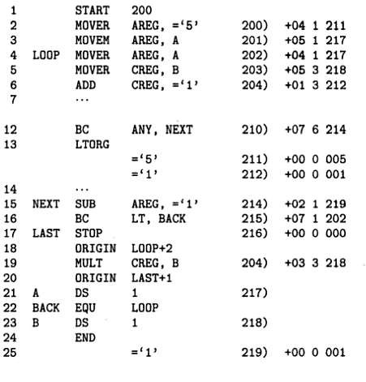

Slide 32
EQU
Defines the symbol to represent <add spec>
Symbol EQU < address specification >
1.
Operand Specification
2. constant
BACK EQU LOOP
BACK EQU 200

Slide 34
Literal, why LTORG?
ADD AREG, =5
What is done internally by assembler?
ADD AREG,FIVE
----
FIVE DC ‘5’

Slide 35

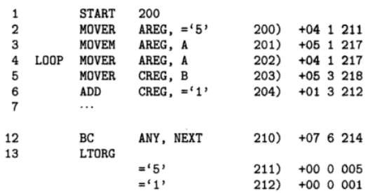
LTORG
· Allows programmer to specify where literals should be stored.

Slide 36

What if we don’t write LTORG?

Slide 37
Design Specification of assembler
Identify the information necessary to perform the task
Design the suitable data structures to record the information
Determine the processing necessary to obtain and manage the information
Determine the information necessary to perform the task

Slide 38
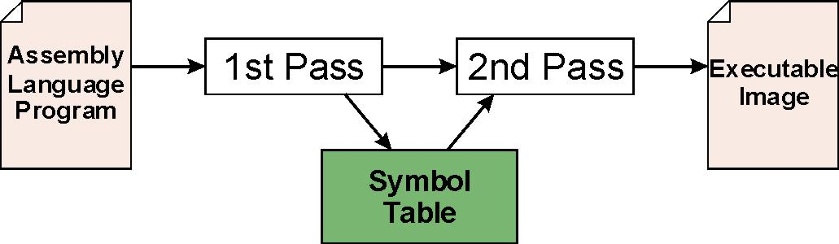
Assembly Process
Convert assembly language file (.asm) into an executable file (.obj) .
First Pass:
scan program file
find all labels and calculate the corresponding addresses; this is called the symbol table
Second Pass:
convert instructions to machine language, using information from symbol table

Slide 39
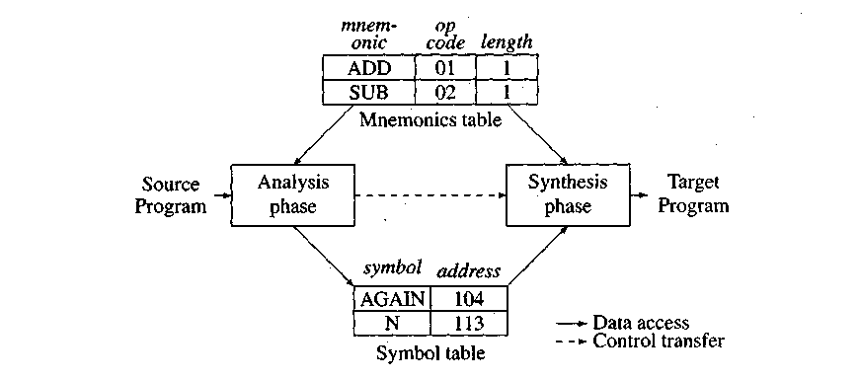
Data structures of the assembler

Slide 40
Data structures for two pass assembler
Mnemonic opcode table
Symbol table
Literal table
Pool table

Slide 41
Mnemonic Operation Codes (Mnemonic opcode)
Instruction Opcode | Assembly Mnemonic | Remarks
00 | STOP | Stops execution
01 | ADD | First operand is
02 | SUB | Modified
03 | MULT
04 | MOVER | Register ← memory move
05 | MOVEM | Memory ← register move
06 | COMP | Sets condition code
07 | BC | Branch on Condition
08 | DIV | Analogous to SUB
09 | READ | Performs reading and
10 | PRINT | printing

Slide 42
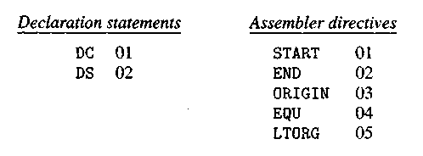
Code for declaration statements and directives

Slide 43



Syntax for BC
BC
Condition code
Memory
Address
LT, LE, EQ, GT, GE, ANY

Slide 44
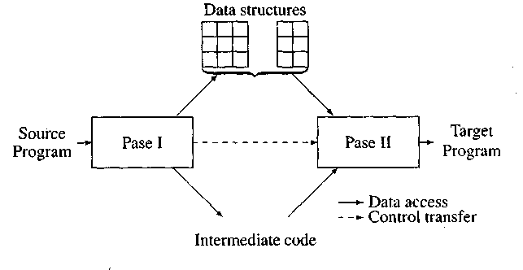
Overview of two pass assembler

Slide 45
Tasks of two pass assembler
Pass 1
Separate the symbol, mnemonic opcode & operand fields.
Build the symbol table, Literal table, Pool table
Perform LC processing
Construct intermediate representation.
Pass 2
Synthesize the target program.
Evaluate fields and generate code
Process pseudo –opcodes

Slide 46
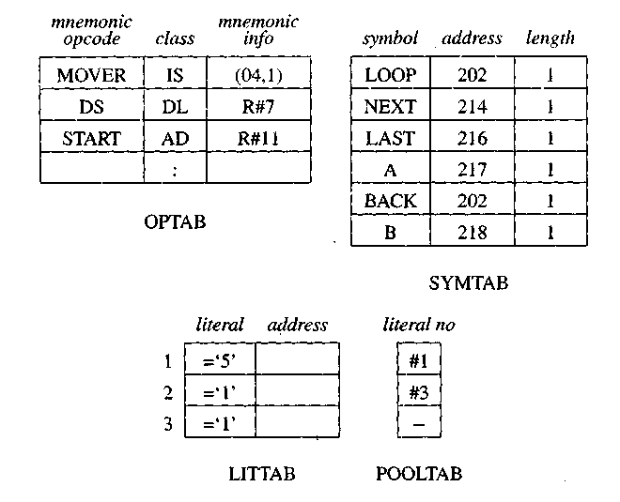
Data structures of assembler pass I

Slide 47


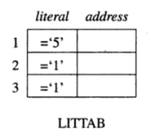
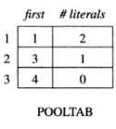
POOLTAB

Slide 48
An Intermediate code unit
Address | Opcode | Operands

Slide 49
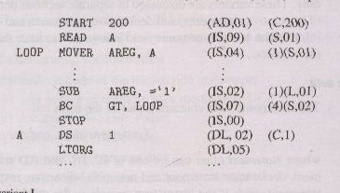
Intermediate code – variant I

Slide 50
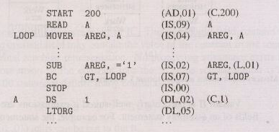
Intermediate code – variant II

Slide 51
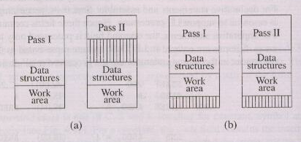
Memory requirements using variant I (a) and variant II (b)

Slide 52
Back patching
The operand field of an instruction is containing forward reference is kept blank initially.
The address of that symbol is put into field when its address is encountered.

Slide 53


Tasks of analysis phase
1. Separate label, opcode & operand
2. Build the symbol table
Analysis
3. Perform LC processing
4. Construct IC

Slide 54
First pass of two pass assembler
MANISHA MALI
54
Input
Machine opcode table (MOT)
Copy of source program (.ASM file)
Output
Location counter
OPTAB
Symbol table (SYMTAB)
Literal table (LITTAB)
Pool table (POOL TAB)
Intermediate representation
Error report
Notes:
54

Slide 55


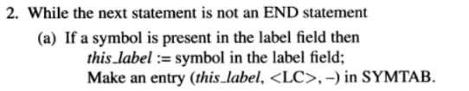
PASS-1 Algorithm

Slide 56
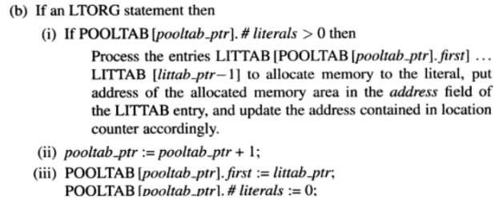
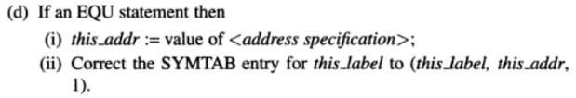

Slide 57
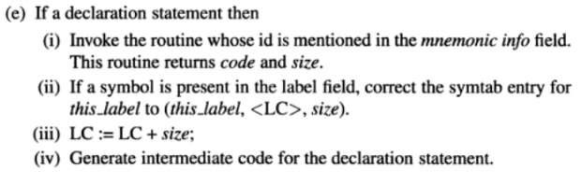
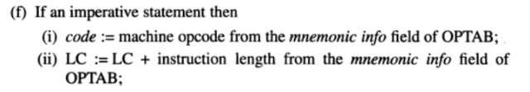

Slide 58
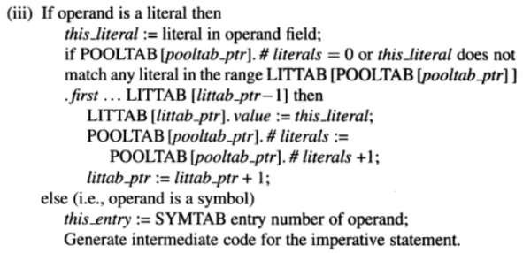


Slide 59
Steps for implementation of First pass of two pass assembler - 1
Create MNEMONIC OPCODE table (OPTAB with mnemonic opcode, class, opcode and length) & make entries in it statically.
Create data structures for SYMBOL Table (SYMTAB with symbol, address & length), LITERAL Table (LITTAB with literal & address) and POOL Table (POOLTAB with literal_no) using array of structure.
Create and open a source file in read mode having assembly language program (e.g. sample.asm)

Slide 60
Steps for implementation of First pass of two pass assembler - 2
4. Open a target file (sample_IC.txt) in write mode
5. Initialize variables like loc_cntr = 0 & so on
6. Scan/read source file word by word and proceed as per the algorithm i.e. compare tokens with OPTAB.
7. While doing step 6 make entries in SYMTAB, LITTAB, POOLTAB & intermediate code in target file
8. Show errors at the end
9. Close all files

Slide 61
Tasks of synthesis phase
1. Obtain the machine opcode corresponding to
the mnemonic
2. Obtain the address of a
memory operand from symbol table
Synthesis
3. Synthesize the machine
instruction

Slide 62
Algorithm : Second pass of two pass assembler
MANISHA MALI
62
Input
Machine opcode table(MOT)
Location counter
Symbol table (SYMTAB)
Literal table (LITTAB)
Pool table (POOL TAB)
Intermediate representation
Output
Machine code
Error report
Notes:
62

Slide 63
Machine instruction format and example
Sign(1) | Opcode(2) | Reg Operand(1) | Memory Operand(3)

Slide 64
Intermediate code – variant I

Slide 65
 | START | 101
 | READ | N |  | 101) | + | 09 | 0 | 113
 | MOVER | BREG, | ONE | 102) | + | 04 | 2 | 115
 | MOVEM | BREG, | TERM | 103) | + | 05 | 2 | 116
AGAIN | MULT | BREG, | TERM | 104) | + | 03 | 2 | 116
 | MOVER | CREG, | TERM | 105) | + | 04 | 3 | 116
 | ADD | CREG, | ONE | 106) | + | 01 | 3 | 115
 | MOVEM | CREG, | TERM | 107) | + | 05 | 3 | 116
 | COMP | CREG, | N | 108) | + | 06 | 3 | 113
 | BC | LE, | AGAIN | 109) | + | 07 | 2 | 104
 | MOVEM | BREG, | RESULT | 110) | + | 05 | 2 | 114
 | PRINT | RESULT |  | 111) | + | 10 | 0 | 114
 | STOP |  |  | 112) | + | 00 | 0 | 000
N | DS | 1 |  | 113)
RESULT | DS | 1 |  | 114)
ONE | DC | ‘1’ |  | 115)
TERM | DS | 1 |  | 116)
 | END

Slide 66
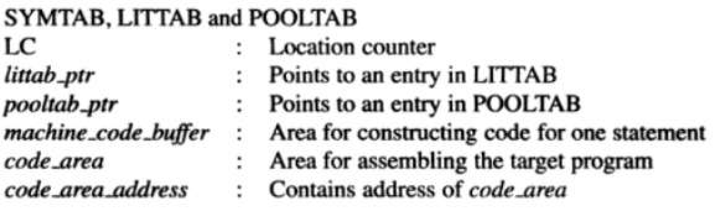
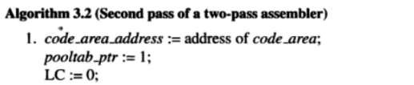
PASS – 2 of assembler

Slide 67
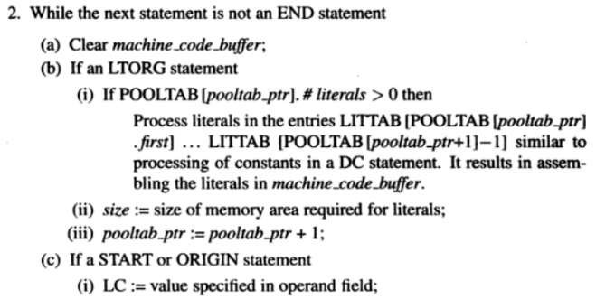
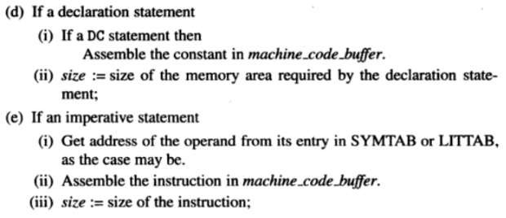

Slide 68


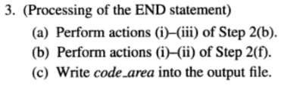

Slide 69
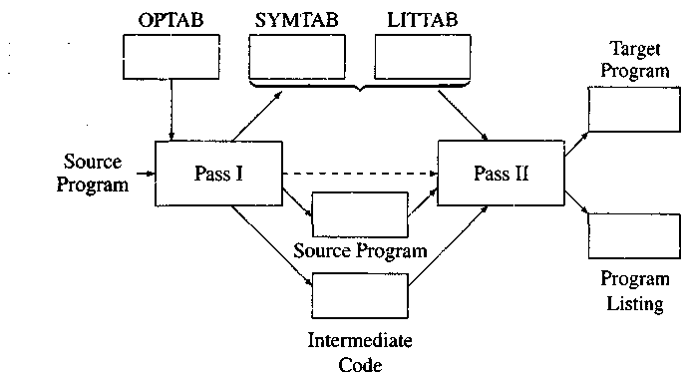
Data structures and files in a two pass assembler

Slide 70
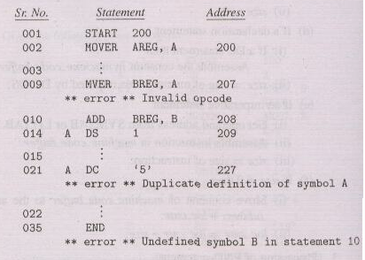
Error reporting in pass I

Slide 71
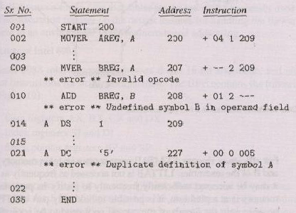
Error reporting in pass II

Slide 72
For the following program which is fed to assembler, show the contents of symbol table and literal table at the end of pass-1. (Assume size of instruction is 1)
START 100 A DS 1 L1 LOAD B ADD C STORE D D EQU A+1 L2 PRINT D ORIGIN A+2 C DC 5 ORIGIN L2+1 STOP B DC ’19’ END

Slide 73
For the following program which is fed to assembler, show the contents of symbol table and literal table at the end of pass-1. (Assume size of instruction is 1)
START 100 LC A DS 1 100 L1 LOAD B 101 ADD C 102 STORE D 103 D EQU A+1 L2 PRINT D 104 ORIGIN A+2 C DC 5 102 ORIGIN L2+1 STOP 105 B DC ’19’ 106 END

Slide 74
Symbol Table
SYMBOL NAME | ADDRESS | LENGTH
A | 100 | 1
L1 | 101 | 1
B | 106 | 1
C | 102 | 1
D | 101 | 1
L2 | 104 | 1

Slide 75
Ex : For the following piece of assembly code, show the contents of symbol table, literal table, pool table and intermediate code after pass I. (8 Mks)
START 100
A DC 01
LOAD A
ADD =‘5’
MULT =‘10’
TRANS L
LTORG
=‘5’
=’10’
L ADD ‘=5’
ADD B
B DS 1
END

Slide 76
Ex : For the following piece of assembly code, show the contents of symbol table, literal table, pool table and intermediate code after pass I. (8 Mks)
START 100
A DC 01 LC= 100
LOAD A LC= 101
ADD =‘5’ LC= 102
MULT =‘10’ LC= 103
TRANS L LC= 104
LTORG
=‘5’ LC= 105
=’10’ LC= 106
L ADD ‘=5’ LC= 107
ADD B LC= 108
B DS 1 LC= 109
END
‘=5’ LC= 110

Slide 77
Ex : For the following piece of assembly code, show the contents of symbol table, literal table, pool table and intermediate code after pass I. (8 Mks)
START 100
A DC 01 LC= 100
LOAD A LC= 101
ADD =‘5’ LC= 102
MULT =‘10’ LC= 103
TRANS L LC= 104
LTORG
=‘5’ LC= 105
=’10’ LC= 106
L ADD ‘=5’ LC= 107
ADD B LC= 108
B DS 1 LC= 109
END
‘=5’ LC= 110
SYMBOL NAME | ADDRESS | LENGTH
A | 100 | 1
L | 107 | 1
B | 109 | 1
LITERAL NAME | ADDRESS
=‘5’ | 105
=‘10’ | 106
=‘5’ | 110

Slide 78
Ex : For the following piece of assembly code, show the contents of symbol table, literal table, pool table and intermediate code after pass I. (8 Mks)
START 100
A DC 01
LOAD A
ADD =‘5’
MULT =‘10’
TRANS L
L ADD ‘=5’
ADD B
B DS 1
END

Slide 79
Ex : For the following piece of assembly code, show the contents of symbol table, literal table, pool table and intermediate code after pass I. (8 Mks)
START 100
A DC 01 LC= 100
LOAD A LC= 101
ADD =‘5’ LC= 102
MULT =‘10’ LC= 103
TRANS L LC= 104
L ADD ‘=5’ LC= 105
ADD B LC= 106
B DS 1 LC= 107
END
=‘5’ LC= 108
=‘10’ LC= 109

Slide 80
Pass structures of assemblers
Two pass translation
Single pass translation
Multi pass translation
e.g. Alpha EQU Beta
Beta EQU Theta
Theta EQU Delta
Delta DC 1

Slide 81
Summary
An assembler is a program that converts assembly language into machine code.
Example of assembler
MASM, NASM, gas, as86, TASM, a86, Terse, etc.

Slide 82
References
D. M. Dhamdhere, Systems Programming and Operating Systems, Tata McGraw-Hill, ISBN 13:978-0-07-463579-7, Second Revised Edition
Alfred V. Aho, Ravi Sethi, Jeffrey D. Ullman, Compilers Principles, Techniques and Tools, Addison Wesley, ISBN:981–235–885 - 4, Low Price Edition
J. J. Donovan, Systems Programming, McGraw-Hill, ISBN 13:978-0-07-460482-3, Indian Edition
https://www.slideshare.net/BhattBalkrishna/ch-3-assembler-in-system-programming

Slide 83


